Slide 1
Team H-Tech
Bison Hackathon 2020

Slide 2




Problem Overview
Lack of transparency
Hesitance to get tested
99% would want to know sexual health of partner
72% were sexually active
78% thought people are not comfortable talking about sexual health
59% said they had been tested
Note: Research was conducted on 152 respondents

Slide 3


Introducing 4Play
A mobile application that promotes the safe exchange of sexual health information and provides education to help facilitate conversations about safe sex.
Features:
Encourages testing
Facilitates safe exchange
Provides education
Sexually active people
Age: 18 - 25

Slide 4
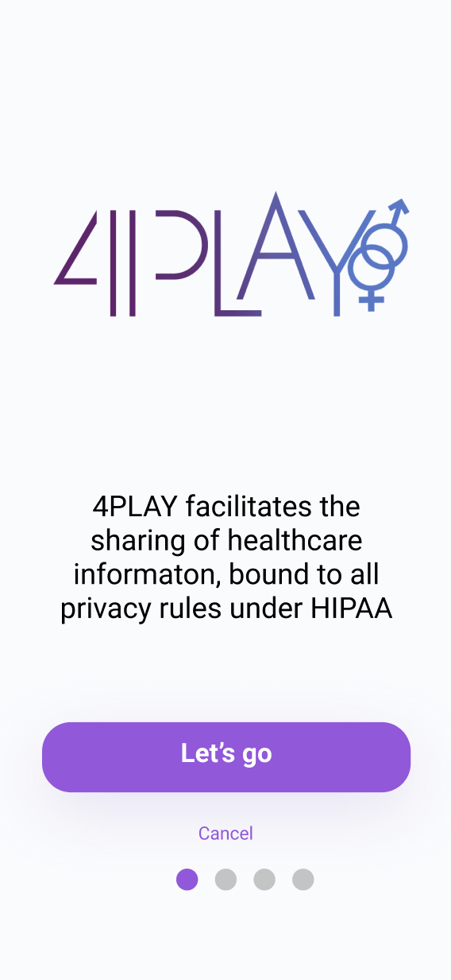
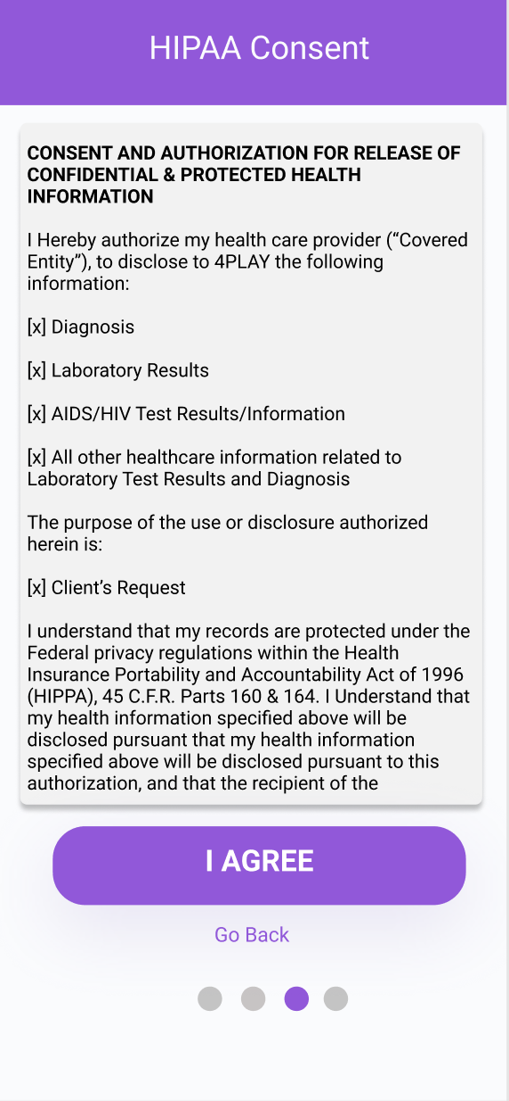
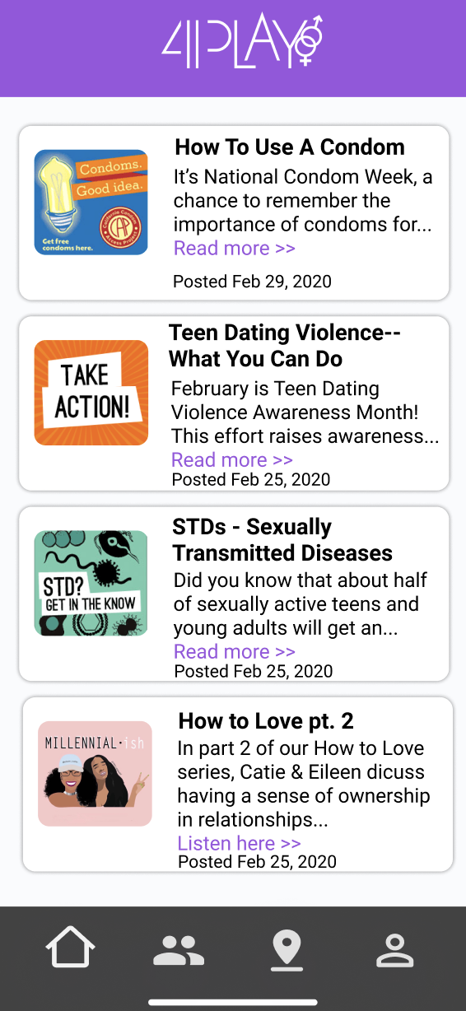
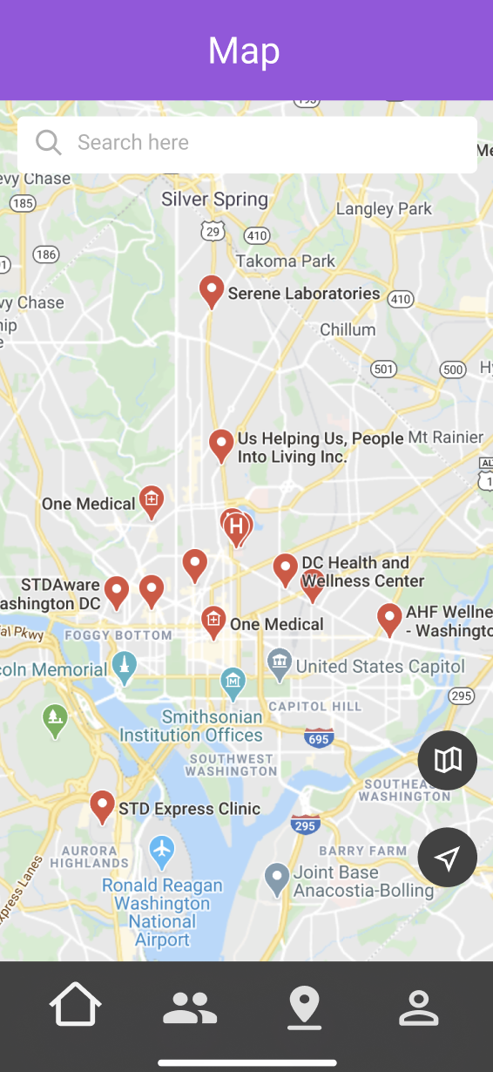
Production Description
Login Page
Consent Form
SexEd New Feed
Clinic Map

Slide 5
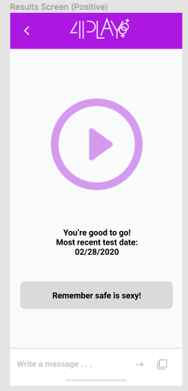
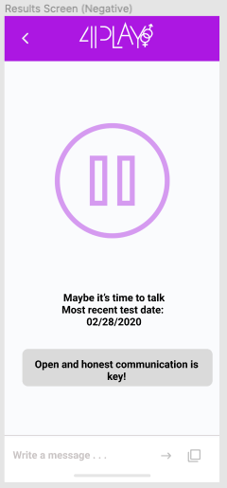


Data Exchange Sample
Mutual Exchange of Information

Slide 6


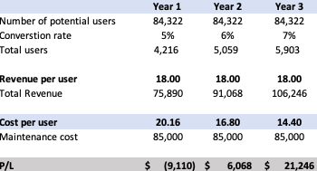



Implementation Strategy
Marketing Strategy
Cost-benefit Analysis
Avg. CPU $17
Revenue Generation
Avg. RPU $18

Slide 7
Know before you go

Slide 8
Q & A

Slide 9
Q & A
Questions: What happens if users screenshot information using primary and secondary device?
Answer: Despite disabling screenshotting features there is the possibility of someone using another device. Our app ensures that the information exchange is discreet and that there’s a level of obscurity.
A disclaimer will be provided to remind users of consequences associated with those actions.
In addition an auditory transfer is a possible solution

Slide 10
Q & A
Questions: How are you addressing privacy breach and liability?
Answer: We plan to contract vetted data security companies such Fireeye and Forcepoint to ensure end to end data protection, as well as the incorporation of AI verification and blockchain. Upon signing up users will provide consent to the use of information thus protecting 4Play and the point of transfer they will still be required to confirm the transfer of data.

Slide 11
Q & A
Questions: How do you plan to build it and fund it?
Answer: We anticipate the cost of the app to be $160,000 based on current health record app that exist today. We plan to acquire funding from the government or social impact investors who believe in the magnitude of this problem

Slide 12
Q & A
Questions: Have you guys considered Hippa laws
Answer: Yes we have. As long users provide consent to the use of this information and the data is stored within laws of Hippa the application will be protected.

Slide 13
Q & A
Questions: Have do you plan to get your first user?
Answer: We plan to market to college campuses and testing clinics to convert recently tested persons to users.

Slide 14
Q & A
Questions: How do you plan to sustain the app if users enter into a committed relationship?
Answer: Our safe sex education feature will continue to be a value add, in addition to continuous encouragement to get tested regularly which will promote a health relationship

Slide 15
Q & A
Questions: Do you have any competitors and how are you differentiated?
Answer: Currently our main competitor does not provide the safe sex education feature and testing notifications. Also the testing information displayed to the other party is too extensive and can be overbearing. They also do not feature the ability to send health information.

Slide 16
Q & A
Questions: Do you have any barriers to entry?
Answer: Our biggest barrier to entry is the current mindset and touchiness of the topic. We believe that our ability to make the information more digestible and common we can facilitate a culture shift and enable safe sexual health practices.

